Slide 1
30122 Final Project: How COVID-19 Influences Job Interview Behaviors
March 9, 2022
Baotong Zhang, Guangyuan Chen, Sophie Wang, Zhe Zhang

Slide 2
Project Overview
Goal
- Driven by curiosity
- Hypothesis: Job interview behaviors may have changed due to the pandemic
- Specifically look at interview questions
Methods
- Web scraping
- Text analysis
- Data visualization
Why should we care?
Social Science Implication: This project studies a social phenomenon influenced by COVID-19, in the context of workplace and operational management.

Slide 3

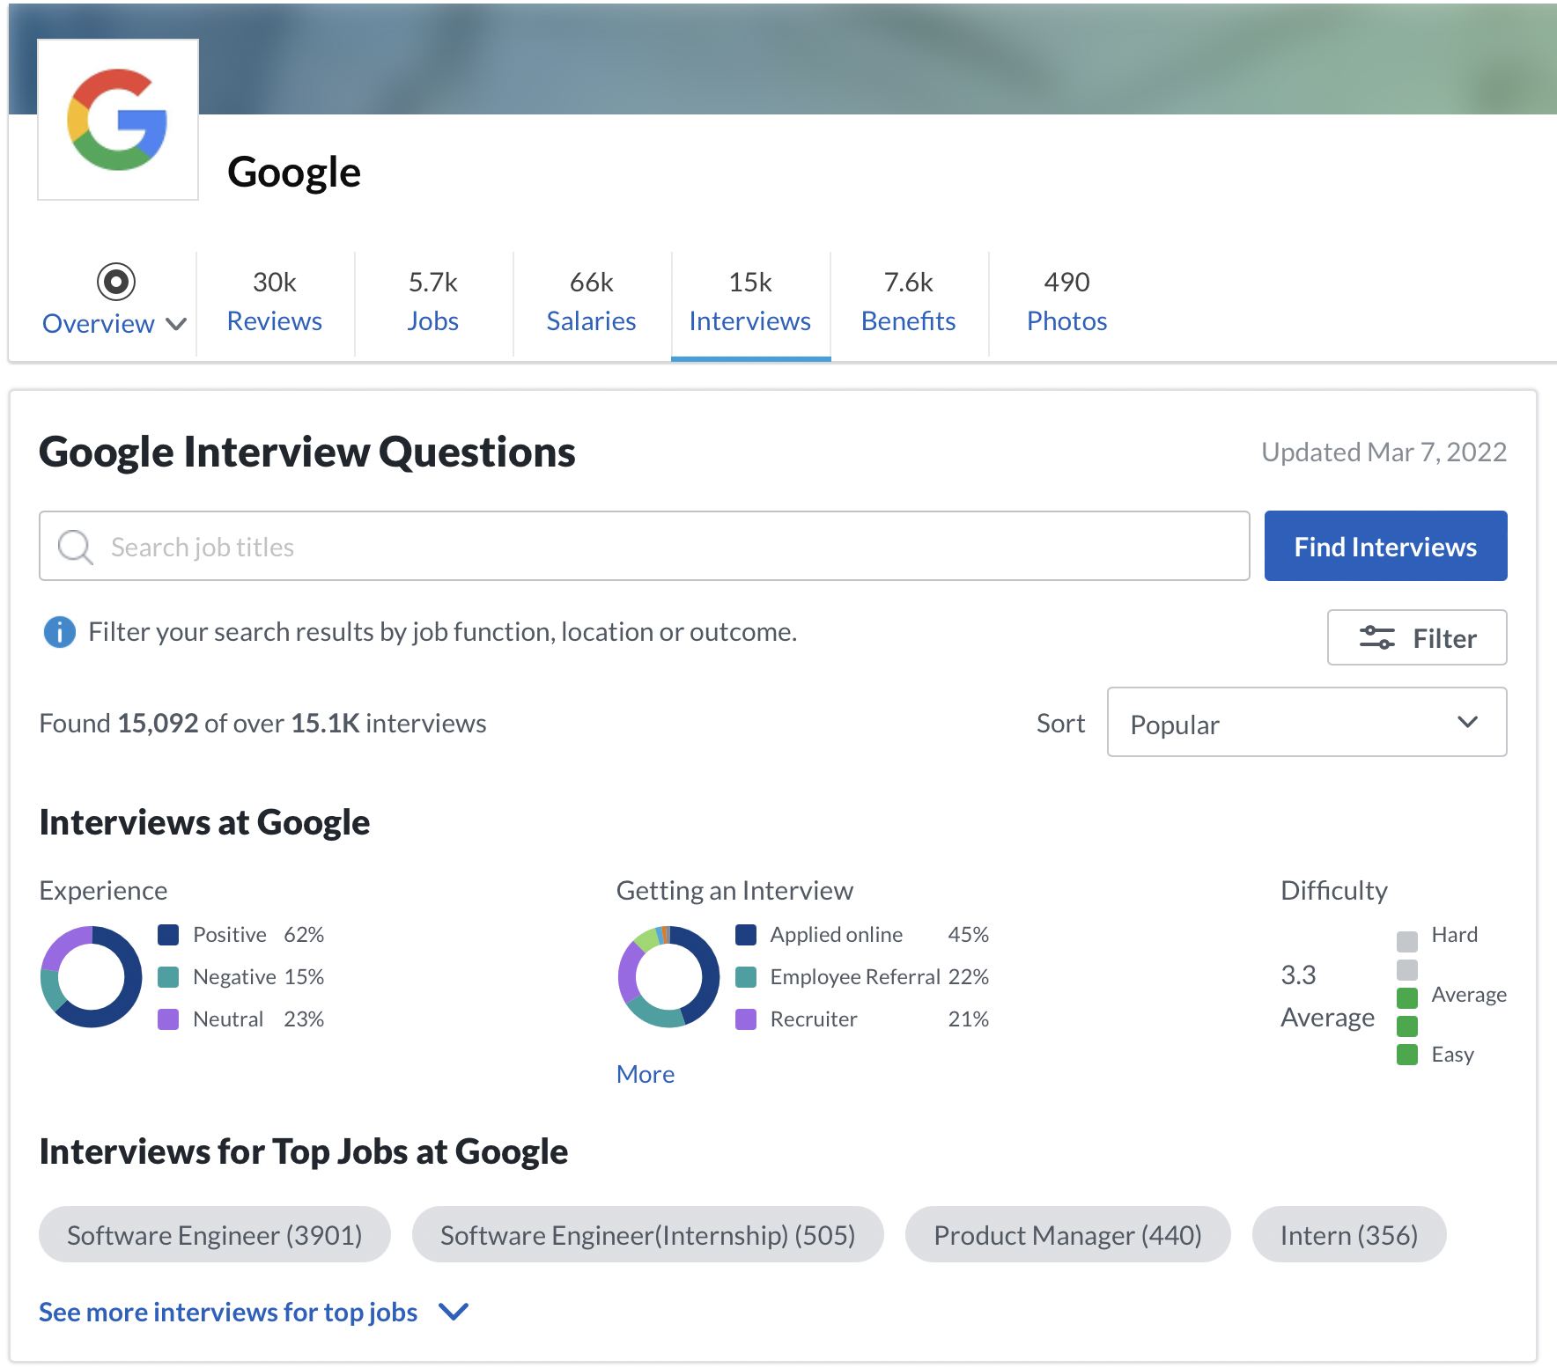
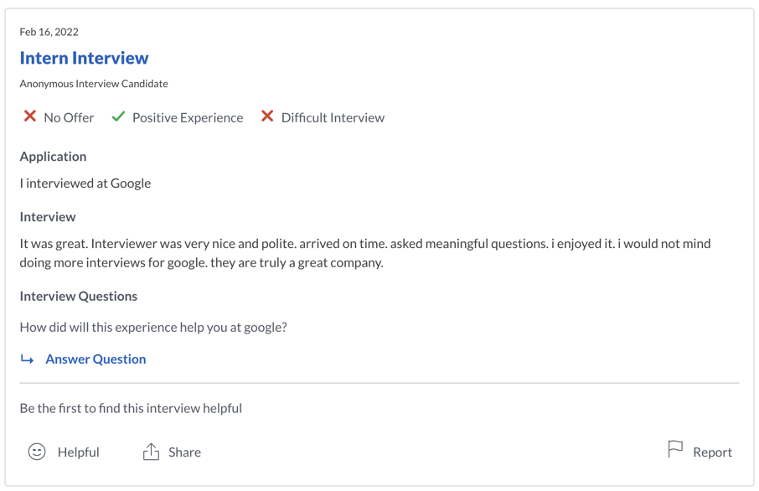
A Closer Look of Our Data…
Source 1 - Glassdoor: find interview questions
- Didn’t use existing statistics as we seek to analyze something new
- Company name → Interviews → Interview & interview questions (why?)

Slide 4

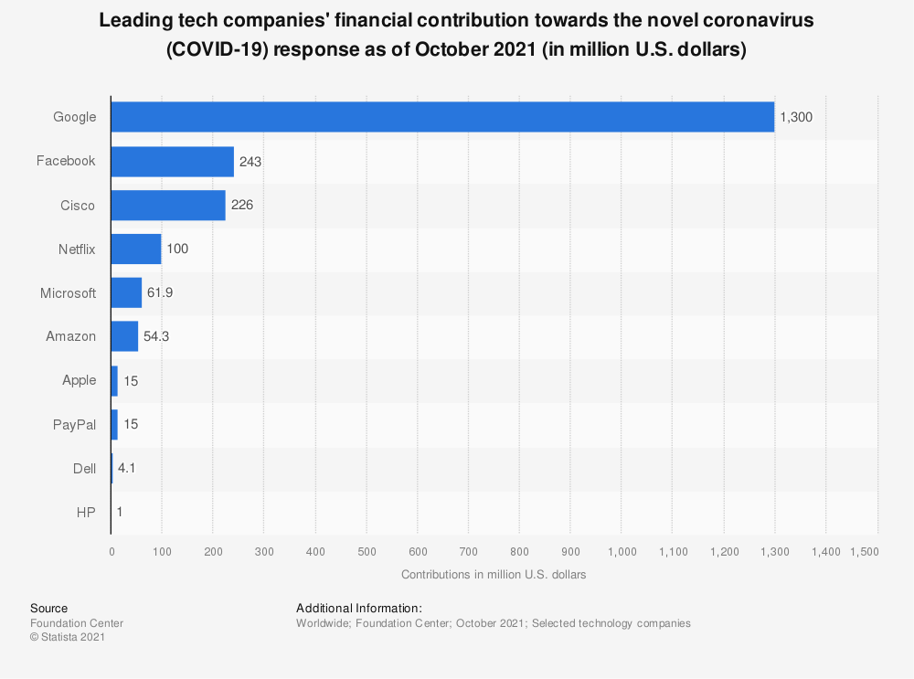
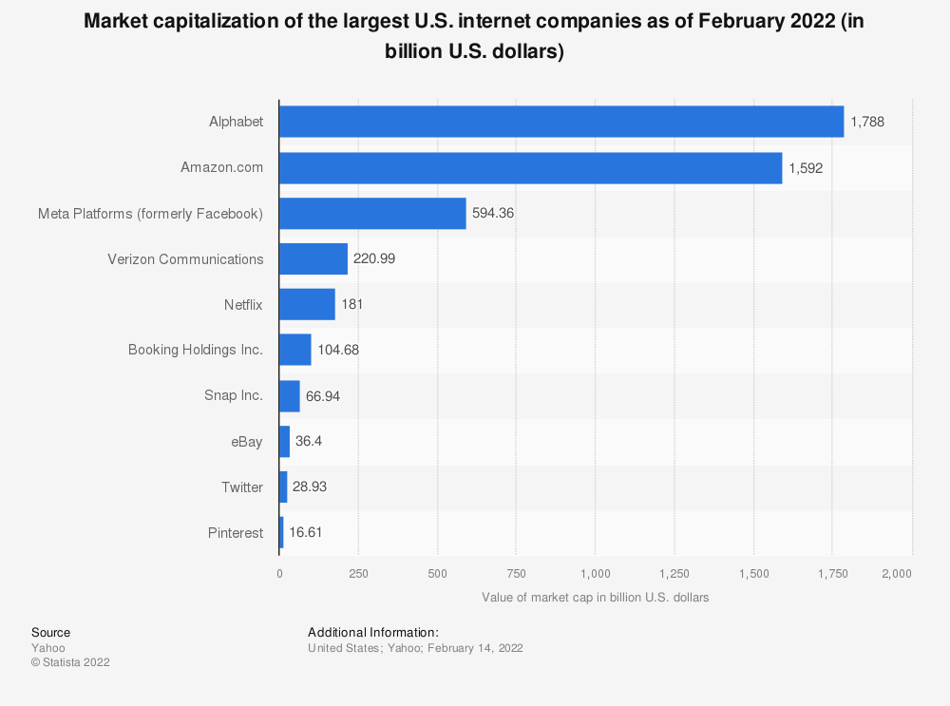
A Closer Look of Our Data…
Source 2 - Statista: find targeted companies
- Our benchmark: Tech giants that appeared in both graphs
- Our choice: Google, Meta (formerly Facebook), Amazon, and Netflix

Slide 5
Data Collection
Sample Size
- Data entry: each targeted post on Glassdoor
- From 2009/3/11 to 2020/2/1: 43k
- From 2020/2/1 to 2022/2/23: 22k
Challenges
1. Need to login to scrape data from Glassdoor. Very hard to “login” in the code 2. Data isn’t sorted by date. Can’t do time series analysis directly
Our solutions
1. login from the browser and put the cookies into the header 2. We added a sorting parameter
Total: 65k

Slide 6
Data Cleaning
Turn the text into a list of words (tokenization)
Remove punctuation
Eliminate a word if stripping the punctuation from it yields the empty string
Convert the word to lower case
Eliminate all stop words
Remove URLs and hashtags
Remove characters from foreign languages

Slide 7
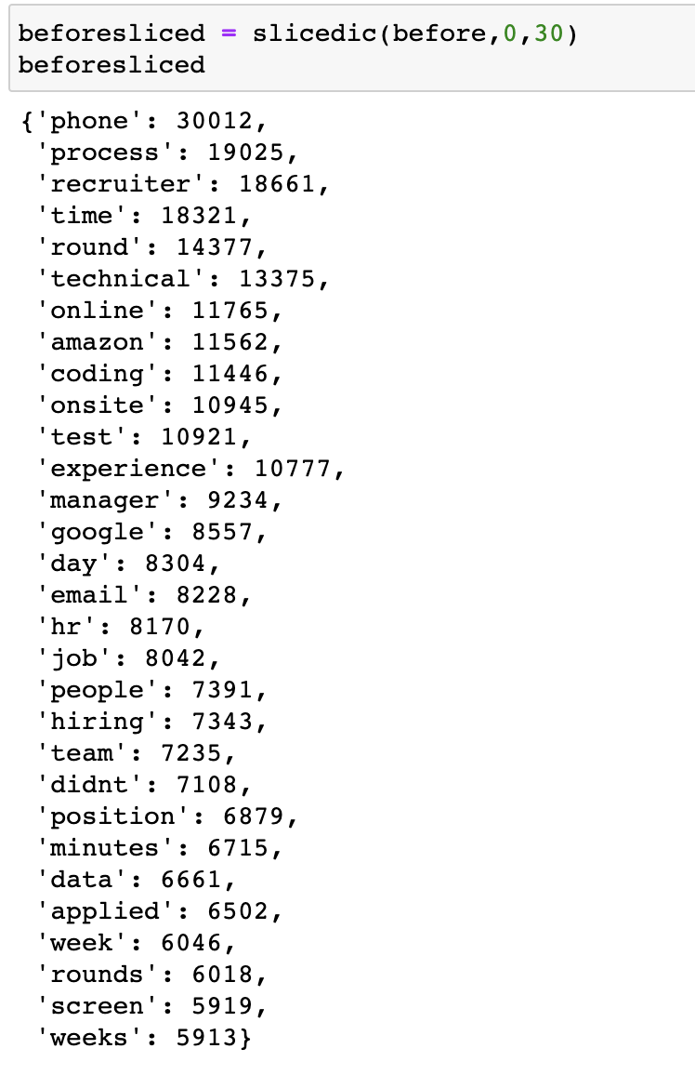
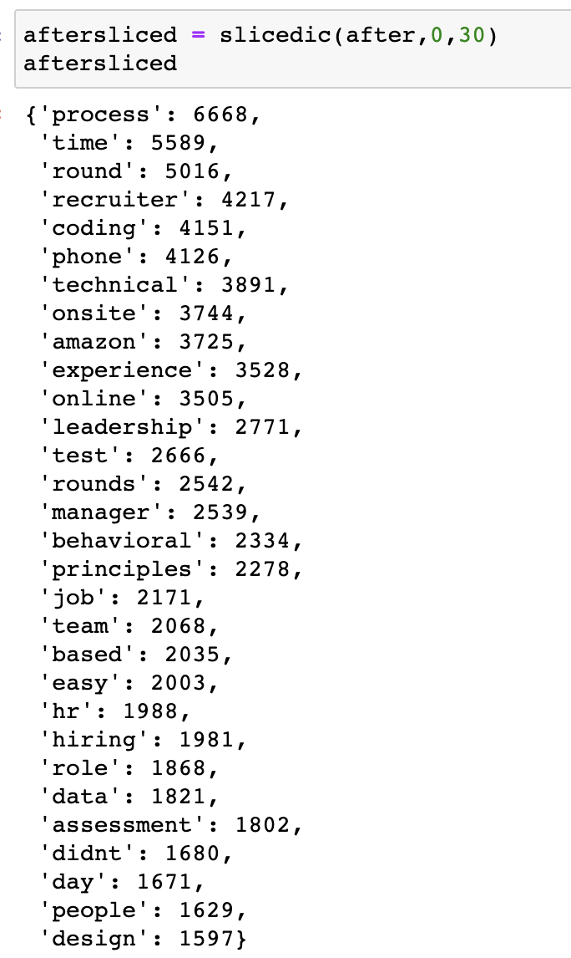
Data Processing
Count word frequency
Form a ranking
Word Frequency Statistics before/after February 1st (top 30)

Slide 8
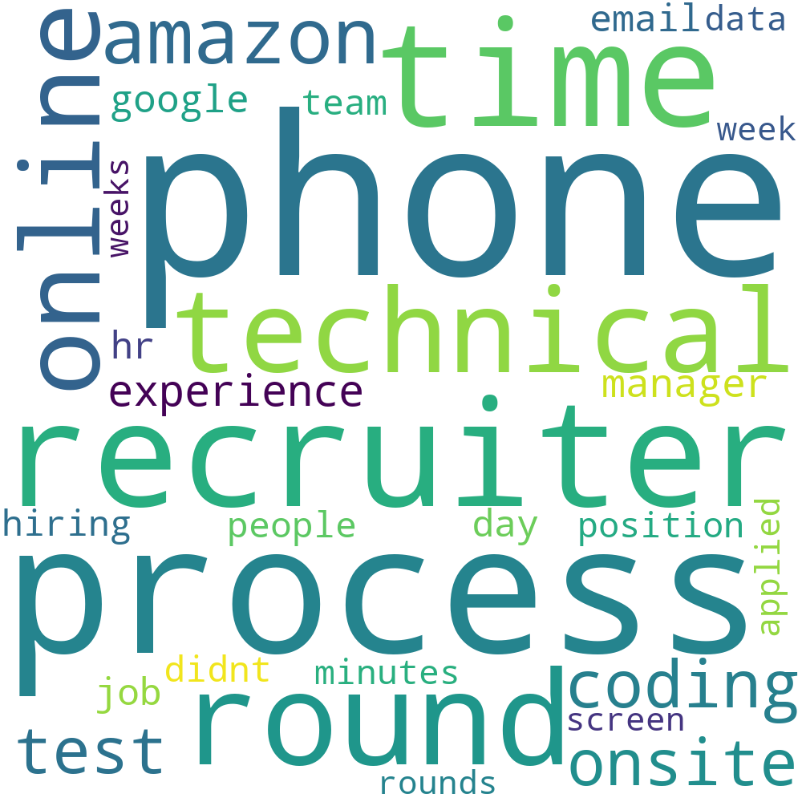
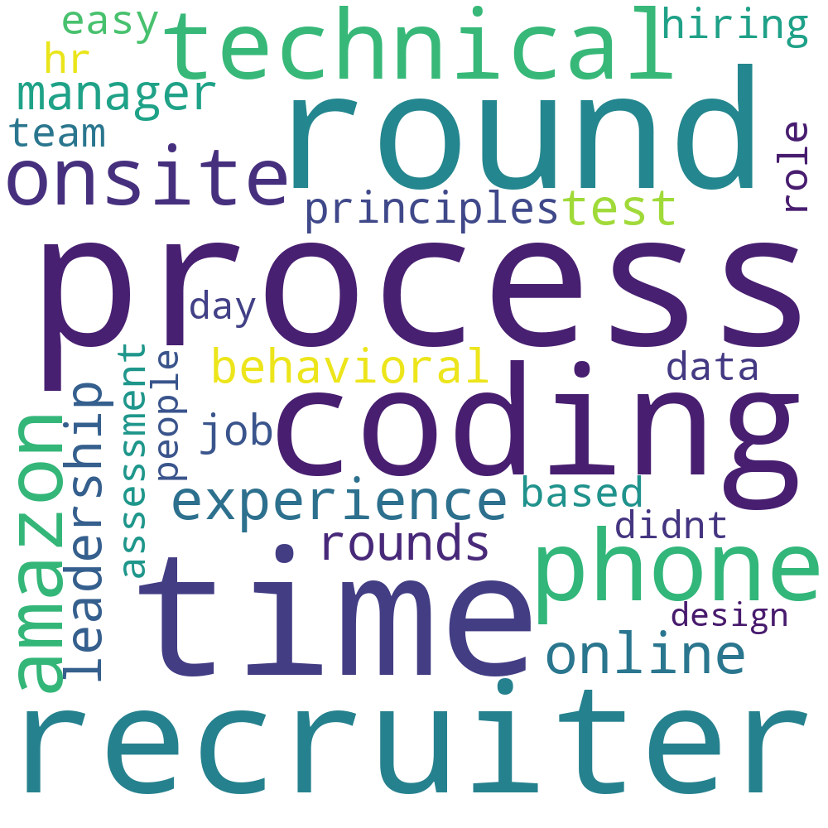
Findings: Data Analysis
2009/3/11-2020/2/1
2020/2/1-2022/2/23
Top 10 keywords: (count of occurrence)
Phone (30,012)
Process (19,025)
Recruiter (18,661)
Time (18,321)
Round (14,377)
Technical (13,375)
Online (11,765)
Amazon (11,562)
Coding (11,446)
Onsite (10,945)
Top 10 keywords:
(count of occurrence)
Process (666,8)
Time (5,589)
Round (5,016)
Recruiter (4,217)
Coding (4,151)
Phone (4,126)
Technical (3,891)
Onsite (3,744)
Amazon (3,725)
Experience (3,528)

Slide 9
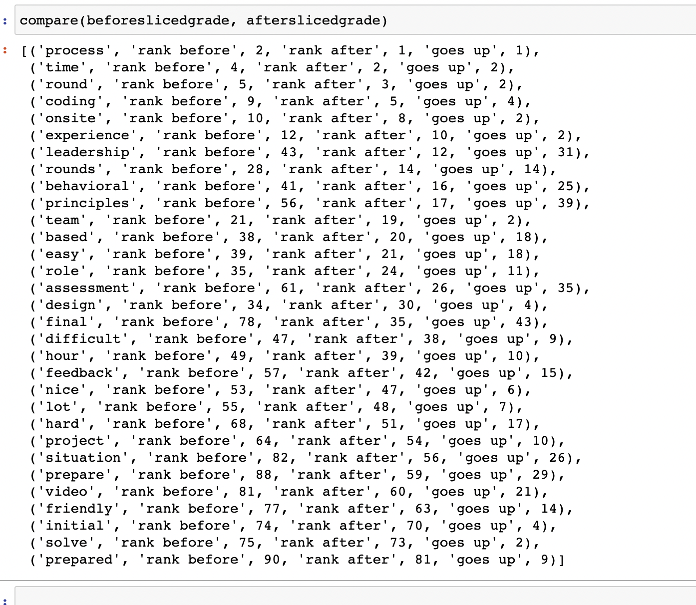
Findings: Data Analysis
Increased Ranking
“Coding” ⬆ 4
“Onsite” ⬆ 2
“Team” ⬆ 2
“ Feedback ” ⬆ 15
“ Video ” ⬆ 21
“ Prepared ” ⬆ 9
“ Leadership” ⬆ 31

Slide 10

Implications
The current COVID-19 pandemic has changed many aspects of our life, including the traditional working environment
- fewer onsite requirements, more WFH
~ 22k data entries in the past two years (people rely on and use internet more)
- People need and use internet more than ever since the pandemic

Slide 11
Our Reflections
What can be done/could’ve been done for improvements?
- We picked tech companies
- Have a more specified list of stop words (currently we used the existing one in the Python package)
- May have new findings using sentiment analysis or n-grams
What are our biggest takeaways from this project?
- Computational methods can provide insights to social science studies
- Allow data to speak for itself

Slide 12
THANK YOU FOR LISTENING!
Baotong Zhang
Guangyuan Chen
Sophie Wang
Zhe Zhang

